Slide 1

Effects on the Fuel Efficiency of Popular Car Brands
Tommy Heaton and Jesse Krinetz

Slide 2
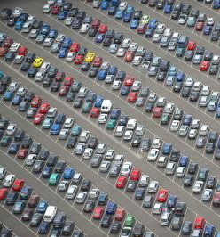
Introduction
Fuel efficiency is a driving factor when shopping for a vehicle.
Our project aims to compare multiple variables to see which ones most influence a vehicle's fuel efficiency, specifically while driving on the highway.

Slide 3
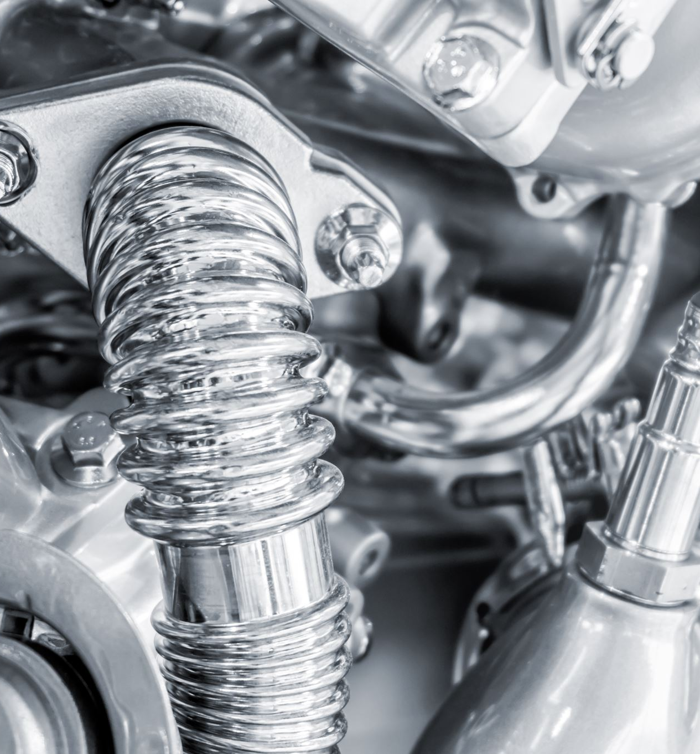
MPG Data Set
Response Variable
Highway fuel economy in terms of miles per gallon – (hwy)
explanatory variables
Engine displacement -(displ)
The count of cylinders - (cyl)
Vehicle class - (class)
Drive type- (drv),
Fuel type - (fl)

Slide 4
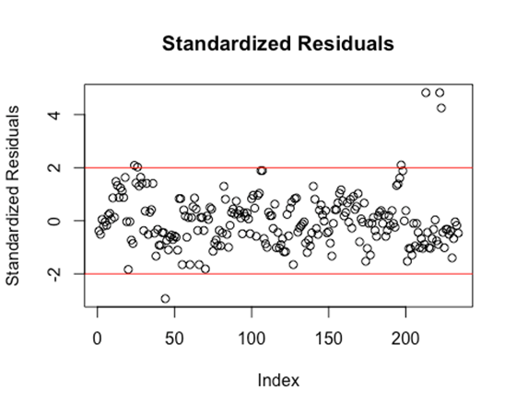
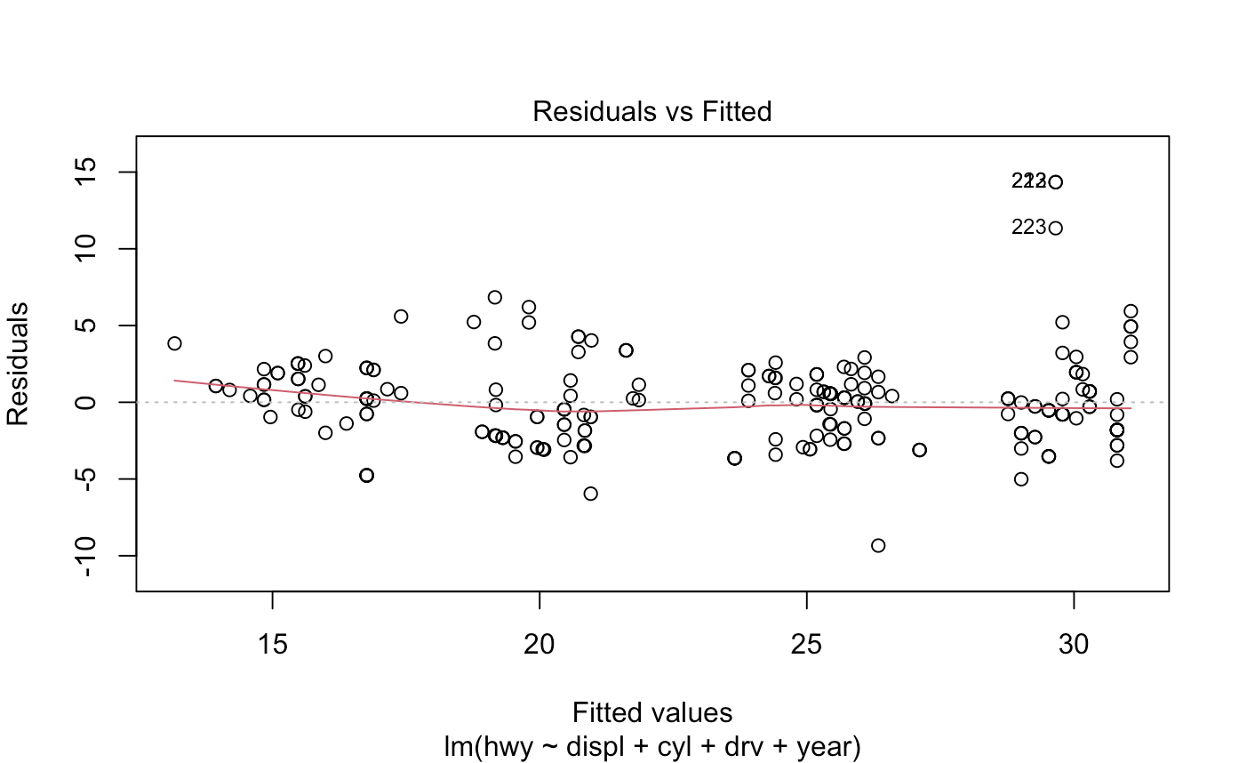
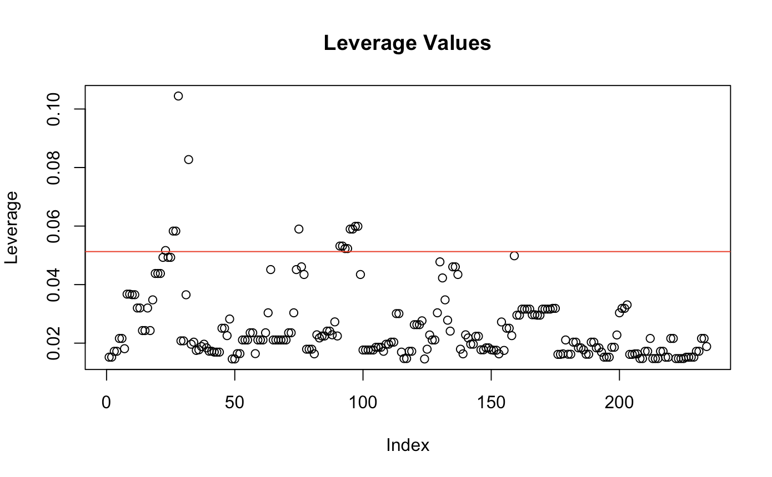
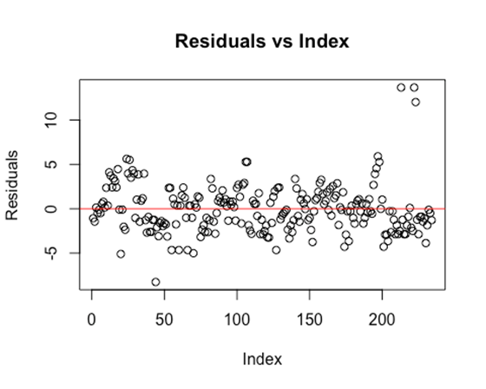
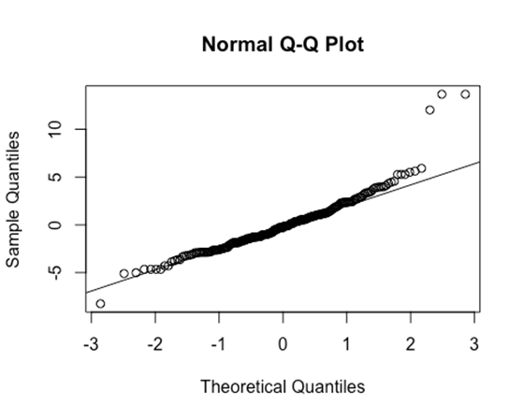
Diagnostics
Variable | VIF
Displ | 3.0839
Cyl | 2.7670
Drv | 1.1910
Year | 1.0134

Slide 5
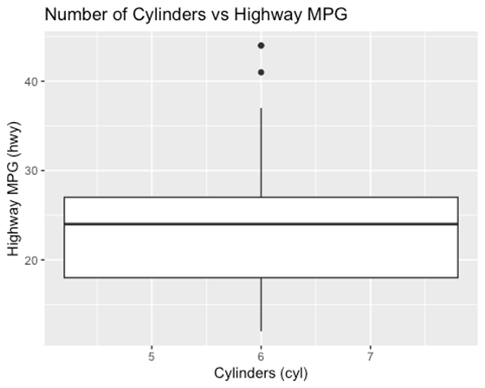
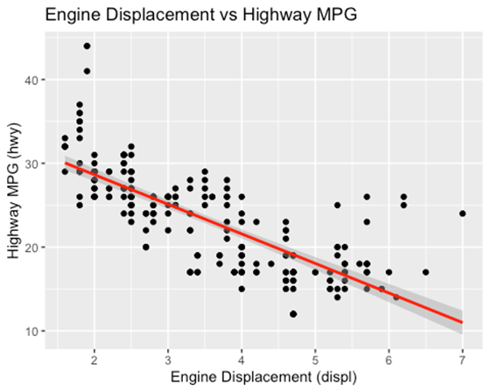
Analysis

Slide 6
Results
Hypothesis Test
H_{o}: B₁ = B₂ = B₃= B₄ =B ₅ = 0
H_{a}: At least one B_{j} ≠ 0
Interpretation
Since the model p-value 2.2e-16 < 0.05 we reject the null hypotheses. There is evident that at least one predictor in the model significantly explains the variation in highway fuel efficiency
R-Squared Value: 0.7671
Variable |  | P-Value | Result
Intercept |  | 0.00367 | Significant
displ |  | 0.00503 | Significant
cyl |  | 2.77e-05 | Significant
drvf |  | < 2e-16 | Significant
drvr |  | 1.36e-11 | Significant
year |  | 0.00104 | Significant
Model |  | 2.2e-16 | Significant

Slide 7
Confidence Intervals
Variable |  | 2.5% | 97.5%
displ |  | -2.1817011 | -0.391591
cyl |  | -2.041782 | -0.7540999
drvf |  | 3.9869941 | 5.968784
drvr |  | 3.5917695 | 5.6785
year |  | 0.05782072 | 0.2263533

Slide 8

Conclusion
Our results demonstrate that highway fuel efficiency is most affected by the number of cylinders in a vehicle and an engines displacement.
More cylinders = lower fuel efficiency
Greater engine displacement = lower fuel efficiency
Now you know when looking for your next vehicle purchase, if highway fuel efficiency is a must, then search for cars with few cylinders and lower engine displacement, such as small compact cars.

